Slide 1

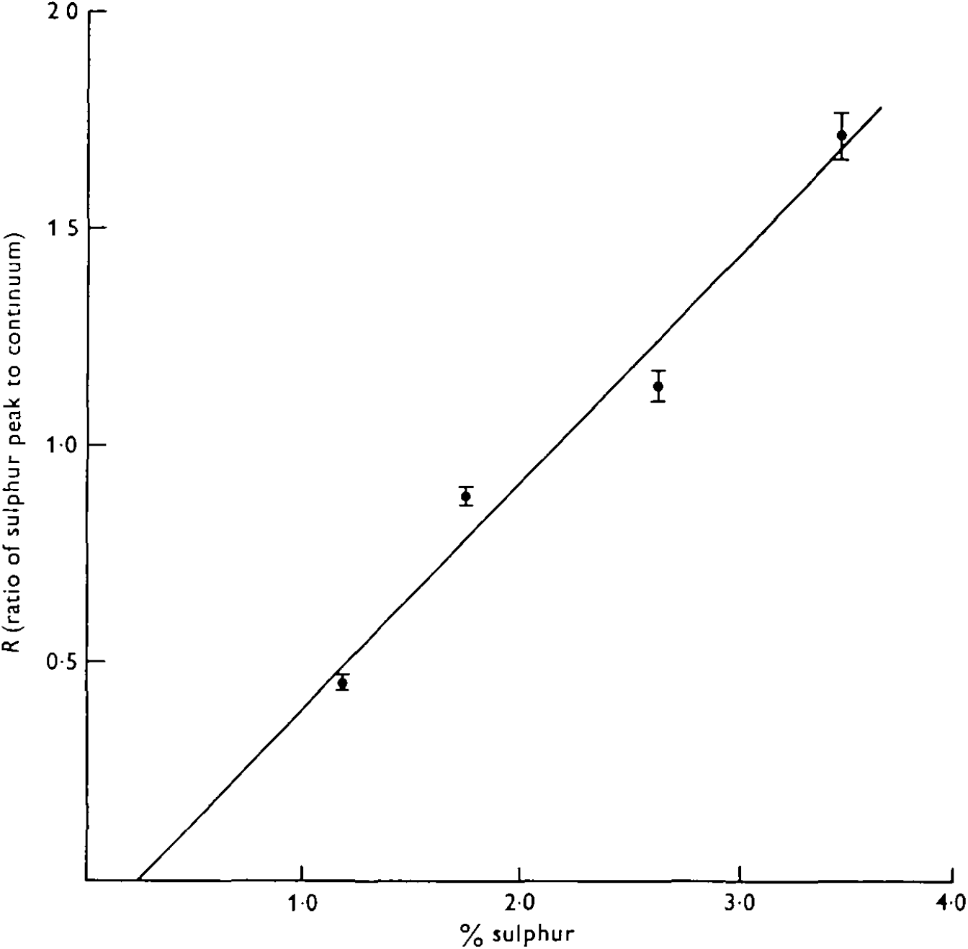
H. Jessen,P. D. Peters,T. A. Hall, Sulphur in different types of keratohyalin granules: a quantitative assay by x-ray microanalysis, J Cell Sci, 1974, Fig. 1.
Fig. 1.
Sulphur in different types of keratohyalin granules: a quantitative assay by x-ray microanalysis
Date downloaded: 4/16/2024
Copyright 2024 The Company of Biologists
Notes:
Figure Caption:
Graph illustrating measured values of R (ratio of sulphur peak to continuum) versus known sulphur concentration in sections from the 4 mixtures of Araldite/DY 041 used as calibration standards.

Slide 2
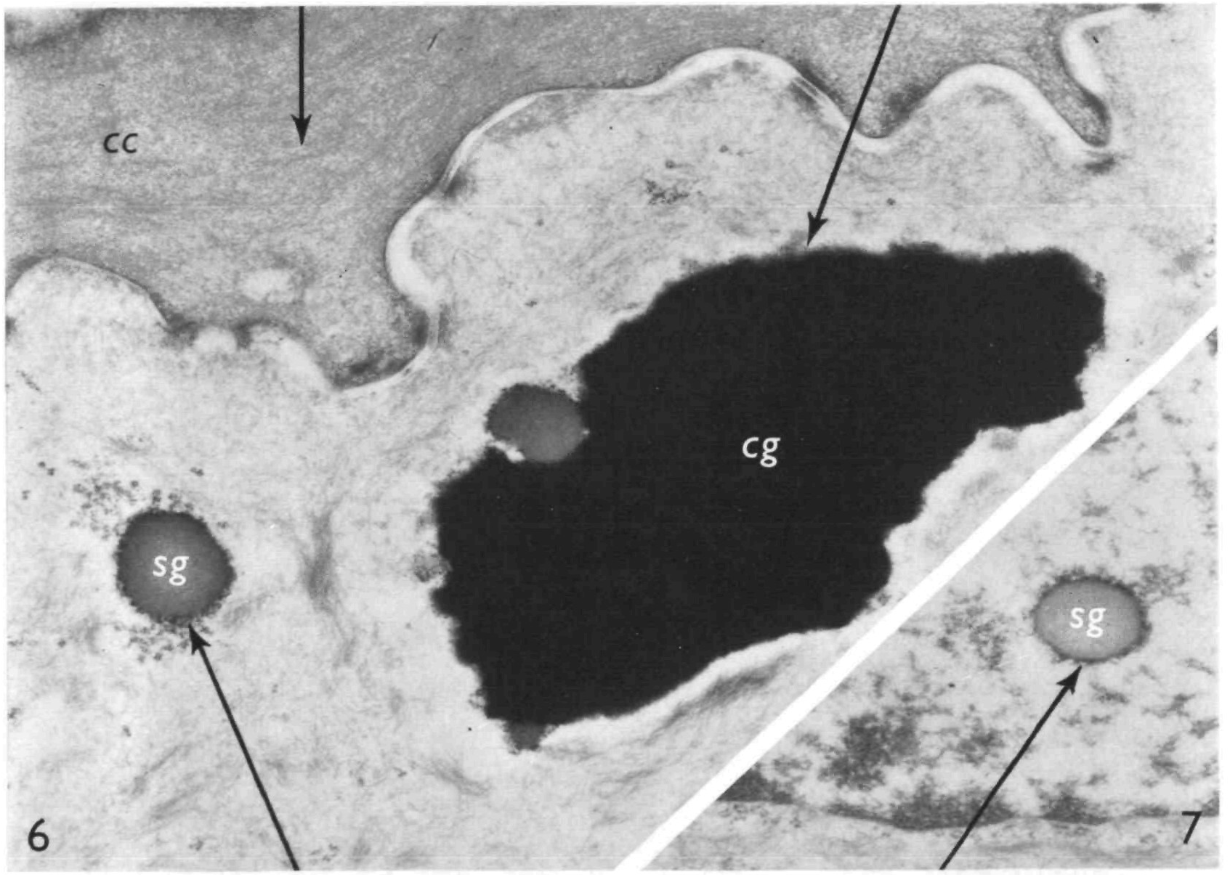
H. Jessen,P. D. Peters,T. A. Hall, Sulphur in different types of keratohyalin granules: a quantitative assay by x-ray microanalysis, J Cell Sci, 1974, Fig. 7.
Fig. 7.
Sulphur in different types of keratohyalin granules: a quantitative assay by x-ray microanalysis
Date downloaded: 4/16/2024
Copyright 2024 The Company of Biologists
Notes:
Figure Caption:
Micrograph showing an intranuclear single granule (sg) from interpapillary tongue epithelium. Glutaraldehyde-fixed, stained section. × 29500.

Slide 3
H. Jessen,P. D. Peters,T. A. Hall, Sulphur in different types of keratohyalin granules: a quantitative assay by x-ray microanalysis, J Cell Sci, 1974, Fig. 6.
Fig. 6.
Sulphur in different types of keratohyalin granules: a quantitative assay by x-ray microanalysis
Date downloaded: 4/16/2024
Copyright 2024 The Company of Biologists
Notes:
Figure Caption:
Micrograph showing the 2 types of keratohyalin granules in interpapillary tongue epithelium. The single granules (sg) show low electron density. The composite granule (cg) is composed of a single granule component and an electron-dense component, cc, cornified cell. Glutaraldehyde-fixed, stained section. × 23 500.

Slide 4
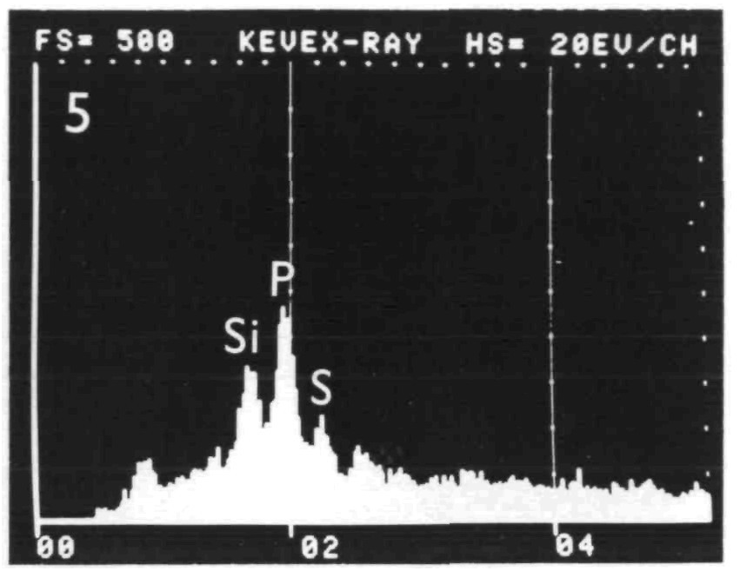
H. Jessen,P. D. Peters,T. A. Hall, Sulphur in different types of keratohyalin granules: a quantitative assay by x-ray microanalysis, J Cell Sci, 1974, Fig. 5.
Fig. 5.
Sulphur in different types of keratohyalin granules: a quantitative assay by x-ray microanalysis
Date downloaded: 4/16/2024
Copyright 2024 The Company of Biologists
Notes:
Figure Caption:
Elemental spectrum from analysis of the electron-dense component of a composite granule. Interpapillary tongue epithelium.

Slide 5
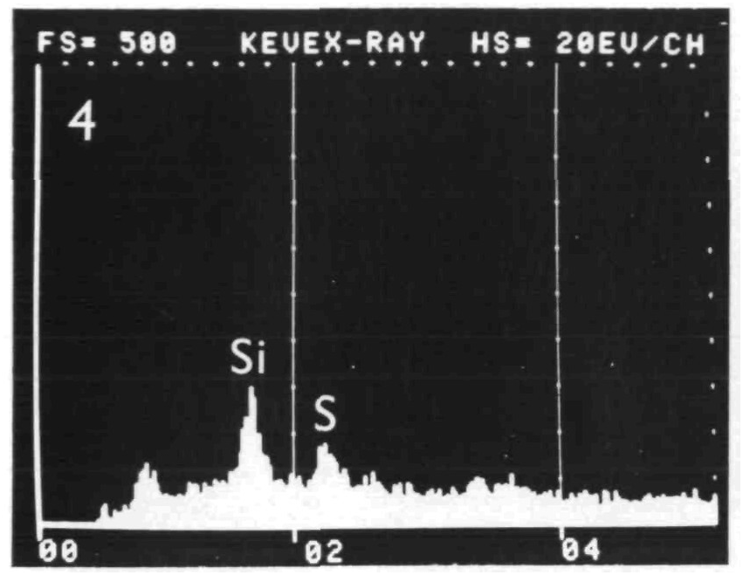
H. Jessen,P. D. Peters,T. A. Hall, Sulphur in different types of keratohyalin granules: a quantitative assay by x-ray microanalysis, J Cell Sci, 1974, Fig. 4.
Fig. 4.
Sulphur in different types of keratohyalin granules: a quantitative assay by x-ray microanalysis
Date downloaded: 4/16/2024
Copyright 2024 The Company of Biologists
Notes:
Figure Caption:
Elemental spectrum from analysis of the interior of a cornified cell. Interpapillary tongue epithelium.

Slide 6
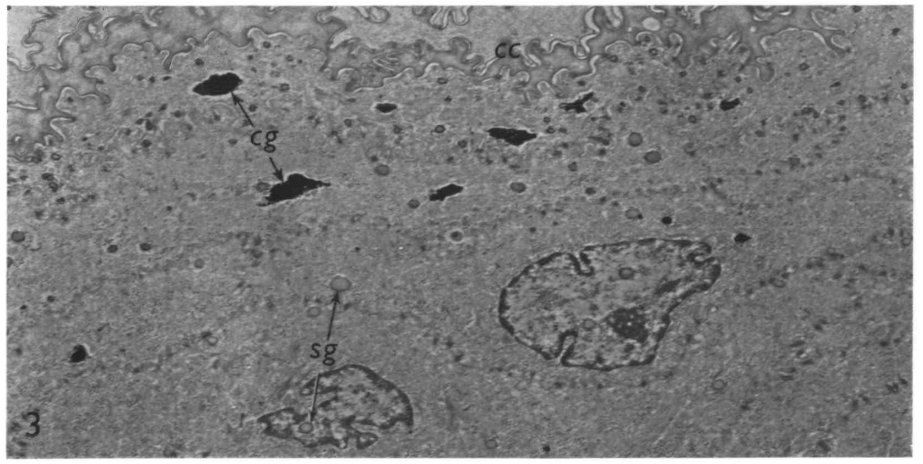
H. Jessen,P. D. Peters,T. A. Hall, Sulphur in different types of keratohyalin granules: a quantitative assay by x-ray microanalysis, J Cell Sci, 1974, Fig. 3.
Fig. 3.
Sulphur in different types of keratohyalin granules: a quantitative assay by x-ray microanalysis
Date downloaded: 4/16/2024
Copyright 2024 The Company of Biologists
Notes:
Figure Caption:
Micrograph showing cells from the granular layer of oesophageal epithelium from the rat. Single keratohyalin granules (sg) are present in both the nuclei and the cytoplasm. Composite keratohyalin granules (cg) are present in the cytoplasm. Cornified cells (cc) are seen in the upper part of the micrograph. Glutaraldehydefixed, stained section. × 6000.

Slide 7
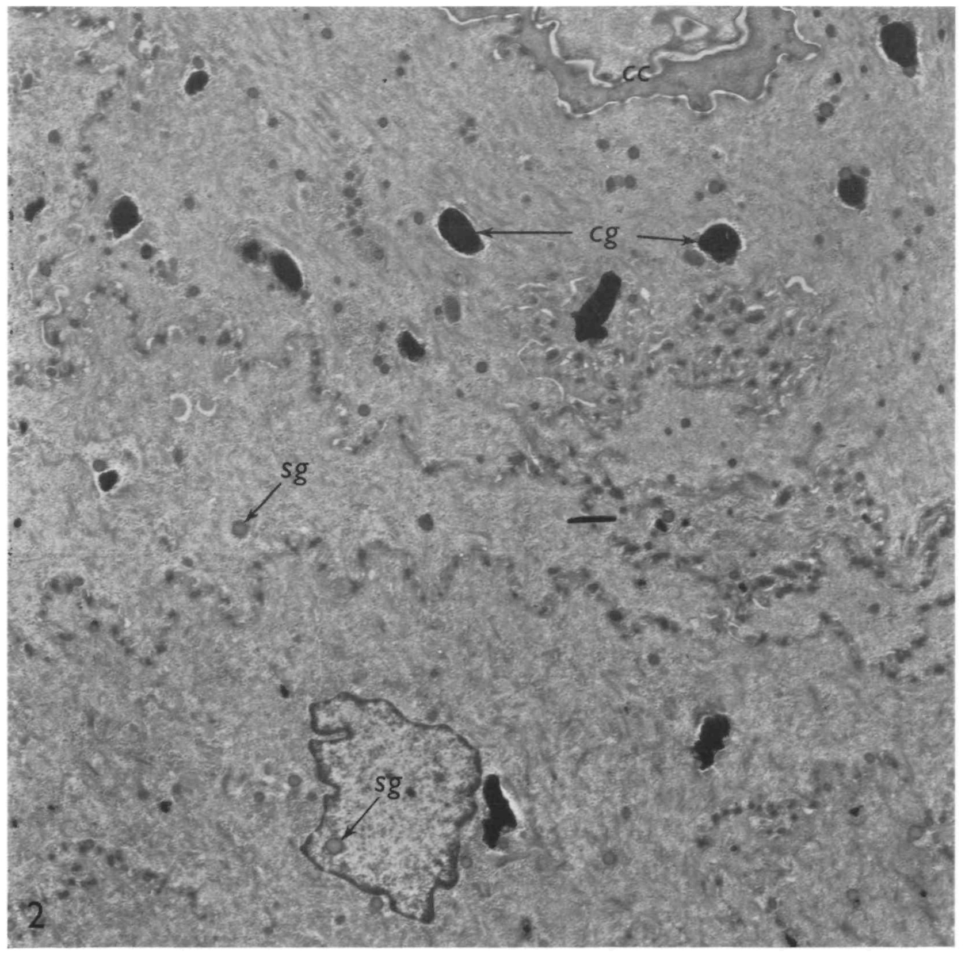
H. Jessen,P. D. Peters,T. A. Hall, Sulphur in different types of keratohyalin granules: a quantitative assay by x-ray microanalysis, J Cell Sci, 1974, Fig. 2.
Fig. 2.
Sulphur in different types of keratohyalin granules: a quantitative assay by x-ray microanalysis
Date downloaded: 4/16/2024
Copyright 2024 The Company of Biologists
Notes:
Figure Caption:
Micrograph showing cells from the granular layer of interpapillary epithelium from the rat tongue. Single keratohyalin granules (sg) are seen in both the nucleus and the cytoplasm. Composite keratohyalin granules (cg) are seen in the cytoplasm. Cornified cells (cc) are seen in the upper part of the micrograph. Glutaraldehydefixed, stained section. × 6ooo.

Slide 8
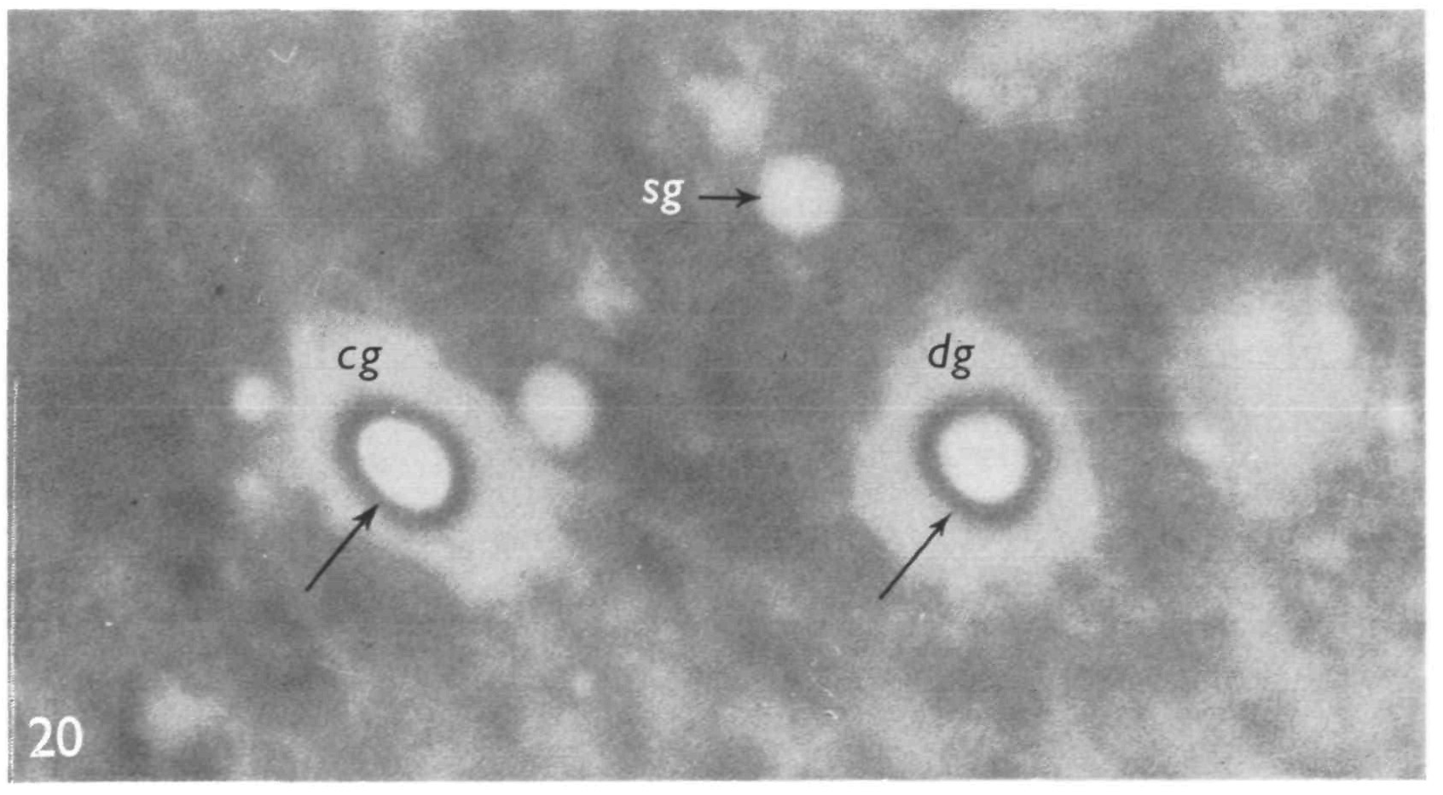
H. Jessen,P. D. Peters,T. A. Hall, Sulphur in different types of keratohyalin granules: a quantitative assay by x-ray microanalysis, J Cell Sci, 1974, Fig. 20.
Fig. 20.
Sulphur in different types of keratohyalin granules: a quantitative assay by x-ray microanalysis
Date downloaded: 4/16/2024
Copyright 2024 The Company of Biologists
Notes:
Figure Caption:
Micrograph showing the 3 types of keratohyalin granules in the filiform papilla in an unstained section, cg, composite granule; dg, dense granule; sg, single granule. Contamination rings - deposited during analysis - are seen over the composite and the dense granules (arrows). × 25000.

Slide 9
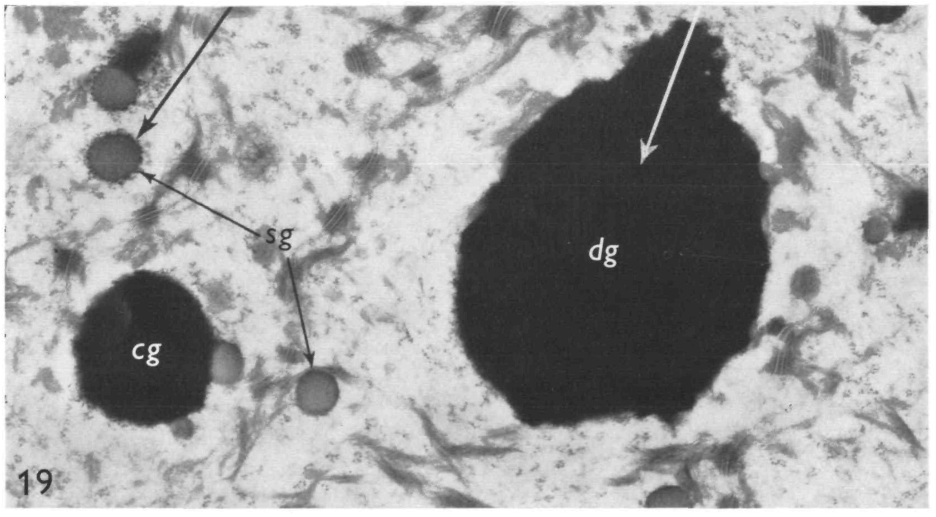
H. Jessen,P. D. Peters,T. A. Hall, Sulphur in different types of keratohyalin granules: a quantitative assay by x-ray microanalysis, J Cell Sci, 1974, Fig. 19.
Fig. 19.
Sulphur in different types of keratohyalin granules: a quantitative assay by x-ray microanalysis
Date downloaded: 4/16/2024
Copyright 2024 The Company of Biologists
Notes:
Figure Caption:
Micrograph showing the different types of keratohyalin granules in the filiform papilla of the rat tongue, cg, composite granule, consisting of a single granule component and a dense component; dg, dense granule; sg, single granules. Glutaraldehyde-fixed, stained section. ×20500.

Slide 10
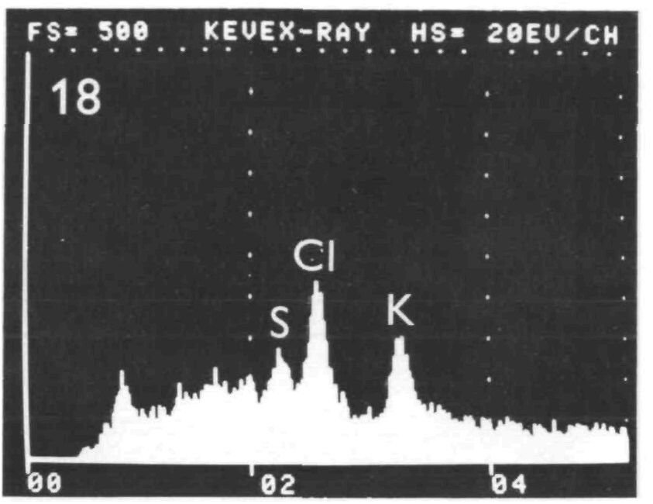
H. Jessen,P. D. Peters,T. A. Hall, Sulphur in different types of keratohyalin granules: a quantitative assay by x-ray microanalysis, J Cell Sci, 1974, Fig. 18.
Fig. 18.
Sulphur in different types of keratohyalin granules: a quantitative assay by x-ray microanalysis
Date downloaded: 4/16/2024
Copyright 2024 The Company of Biologists
Notes:
Figure Caption:
Elemental spectrum from analysis of a dense granule from a filiform papilla.

Slide 11
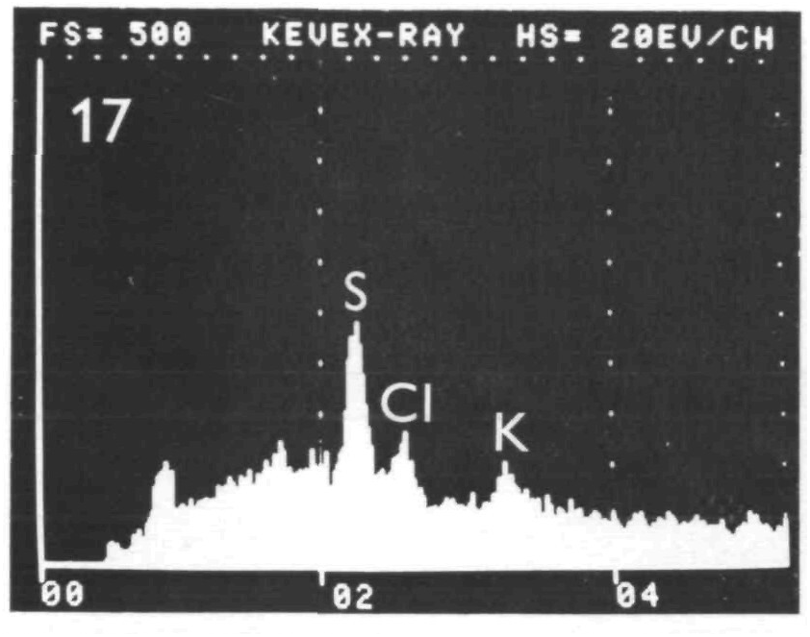
H. Jessen,P. D. Peters,T. A. Hall, Sulphur in different types of keratohyalin granules: a quantitative assay by x-ray microanalysis, J Cell Sci, 1974, Fig. 17.
Fig. 17.
Sulphur in different types of keratohyalin granules: a quantitative assay by x-ray microanalysis
Date downloaded: 4/16/2024
Copyright 2024 The Company of Biologists
Notes:
Figure Caption:
Elemental spectrum from analysis of a single granule from a filiform papilla.

Slide 12
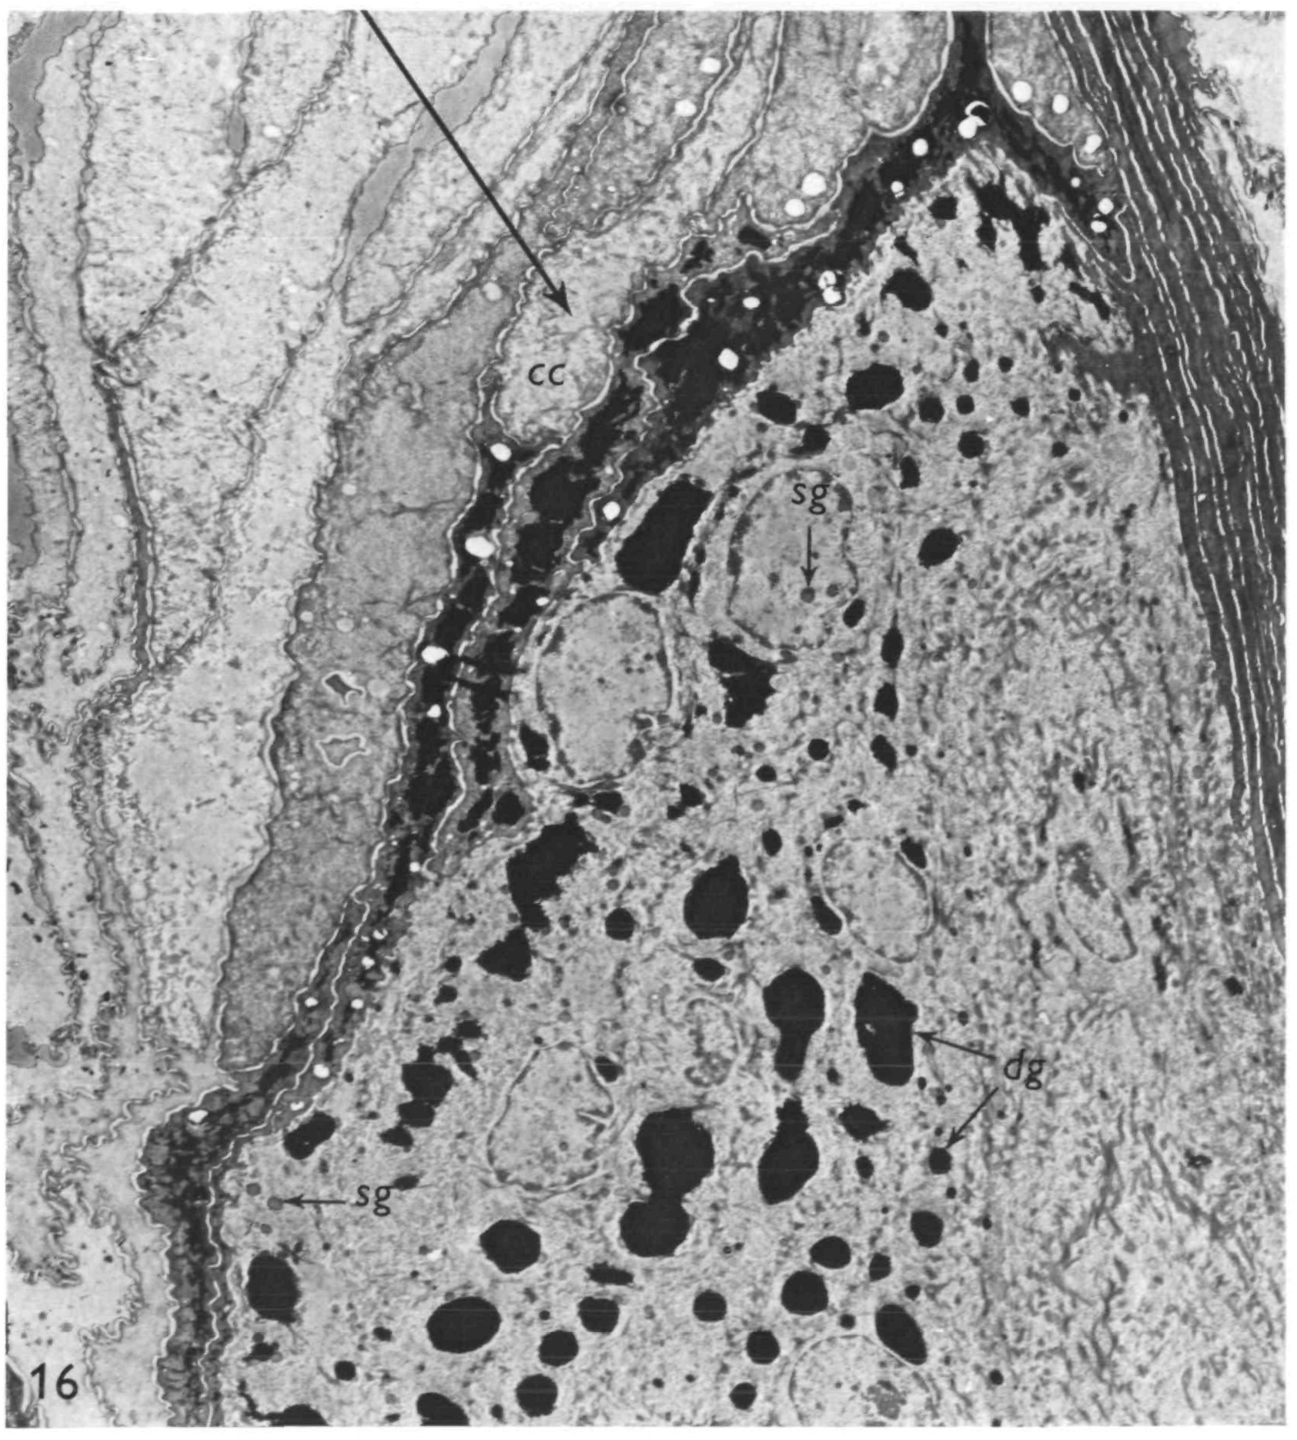
H. Jessen,P. D. Peters,T. A. Hall, Sulphur in different types of keratohyalin granules: a quantitative assay by x-ray microanalysis, J Cell Sci, 1974, Fig. 16.
Fig. 16.
Sulphur in different types of keratohyalin granules: a quantitative assay by x-ray microanalysis
Date downloaded: 4/16/2024
Copyright 2024 The Company of Biologists
Notes:
Figure Caption:
Micrograph showing a filiform papilla of the rat tongue. Keratohyalin granules are seen in the anterior part of the papilla, cc, cornified cell; dg, dense keratohyalin granules; sg, intranuclear and cytoplasmic single granules. Glutaraldehyde-fixed, stained section. × 4000.

Slide 13
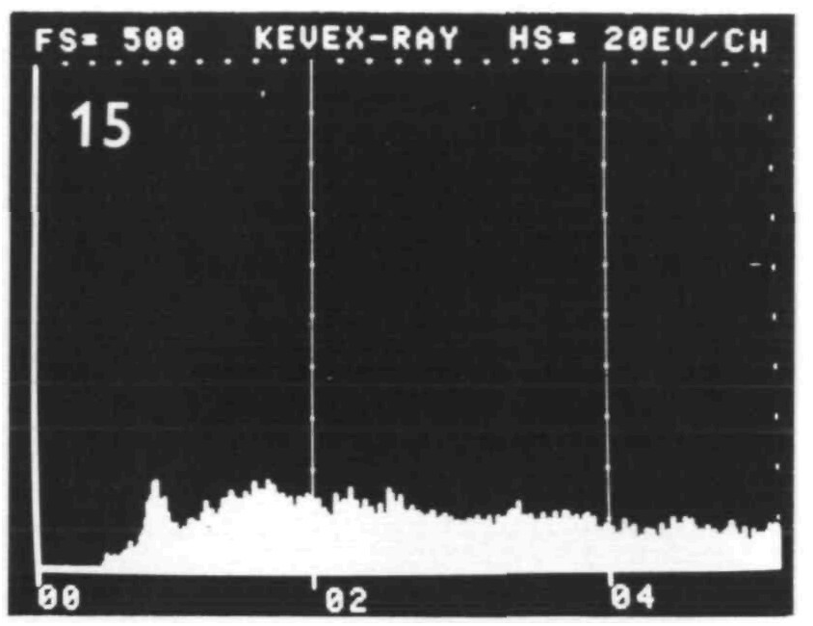
H. Jessen,P. D. Peters,T. A. Hall, Sulphur in different types of keratohyalin granules: a quantitative assay by x-ray microanalysis, J Cell Sci, 1974, Fig. 15.
Fig. 15.
Sulphur in different types of keratohyalin granules: a quantitative assay by x-ray microanalysis
Date downloaded: 4/16/2024
Copyright 2024 The Company of Biologists
Notes:
Figure Caption:
Elemental spectrum from analysis of Araldite.

Slide 14
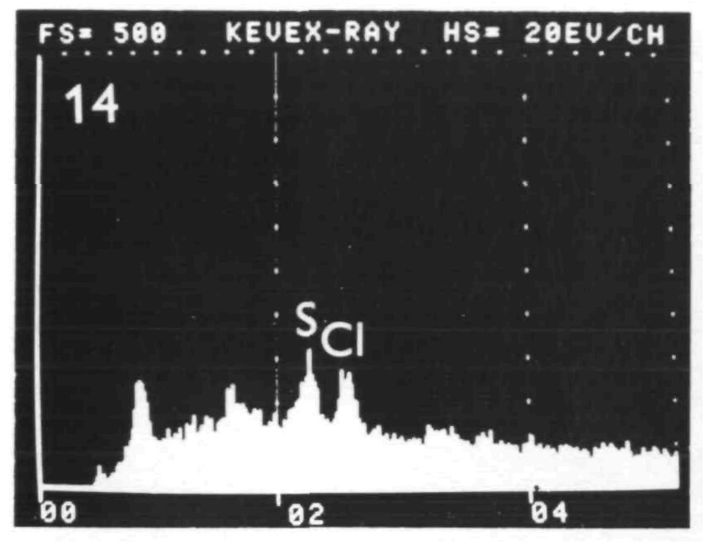
H. Jessen,P. D. Peters,T. A. Hall, Sulphur in different types of keratohyalin granules: a quantitative assay by x-ray microanalysis, J Cell Sci, 1974, Fig. 14.
Fig. 14.
Sulphur in different types of keratohyalin granules: a quantitative assay by x-ray microanalysis
Date downloaded: 4/16/2024
Copyright 2024 The Company of Biologists
Notes:
Figure Caption:
Elemental spectrum from analysis of the interior of a cornified cell adjacent to the granular layer of a filiform papilla.

Slide 15
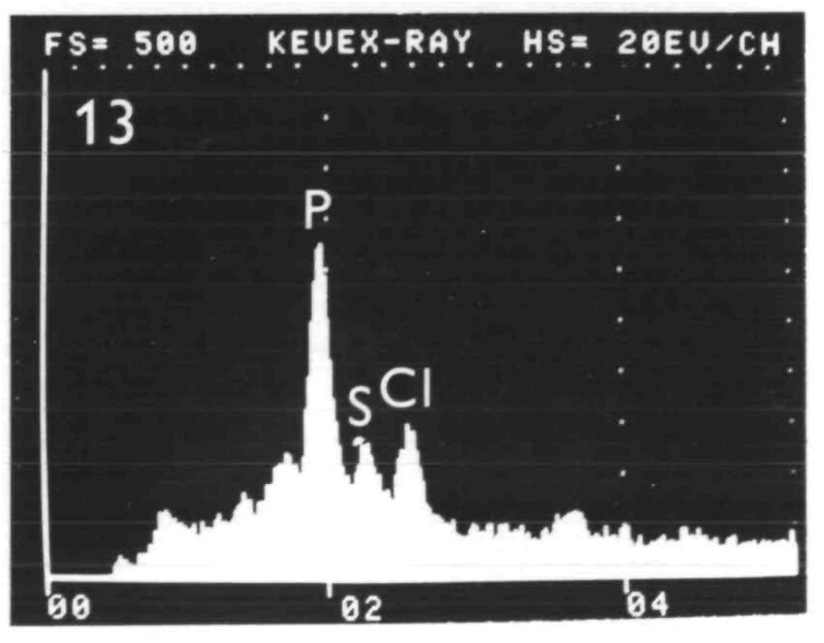
H. Jessen,P. D. Peters,T. A. Hall, Sulphur in different types of keratohyalin granules: a quantitative assay by x-ray microanalysis, J Cell Sci, 1974, Fig. 13.
Fig. 13.
Sulphur in different types of keratohyalin granules: a quantitative assay by x-ray microanalysis
Date downloaded: 4/16/2024
Copyright 2024 The Company of Biologists
Notes:
Figure Caption:
Elemental spectrum from analysis of the dense component of a composite granule. Oesophageal epithelium.

Slide 16
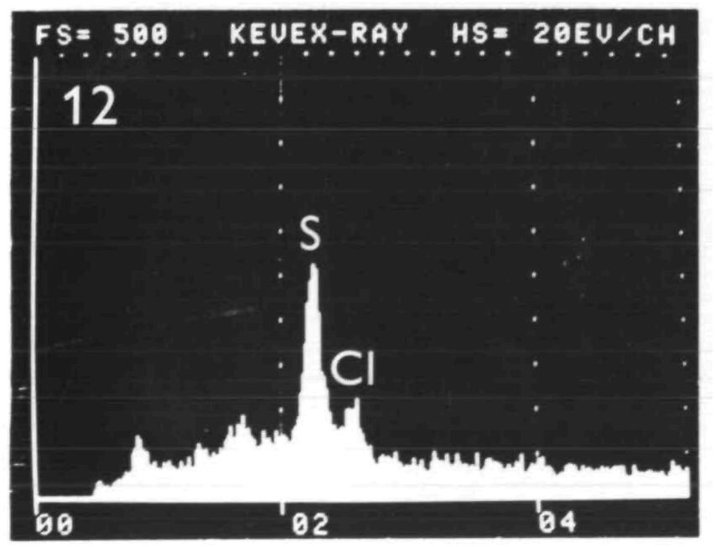
H. Jessen,P. D. Peters,T. A. Hall, Sulphur in different types of keratohyalin granules: a quantitative assay by x-ray microanalysis, J Cell Sci, 1974, Fig. 12.
Fig. 12.
Sulphur in different types of keratohyalin granules: a quantitative assay by x-ray microanalysis
Date downloaded: 4/16/2024
Copyright 2024 The Company of Biologists
Notes:
Figure Caption:
Elemental spectrum from analysis of a cytoplasmic single granule. Oesophageal epithelium.

Slide 17
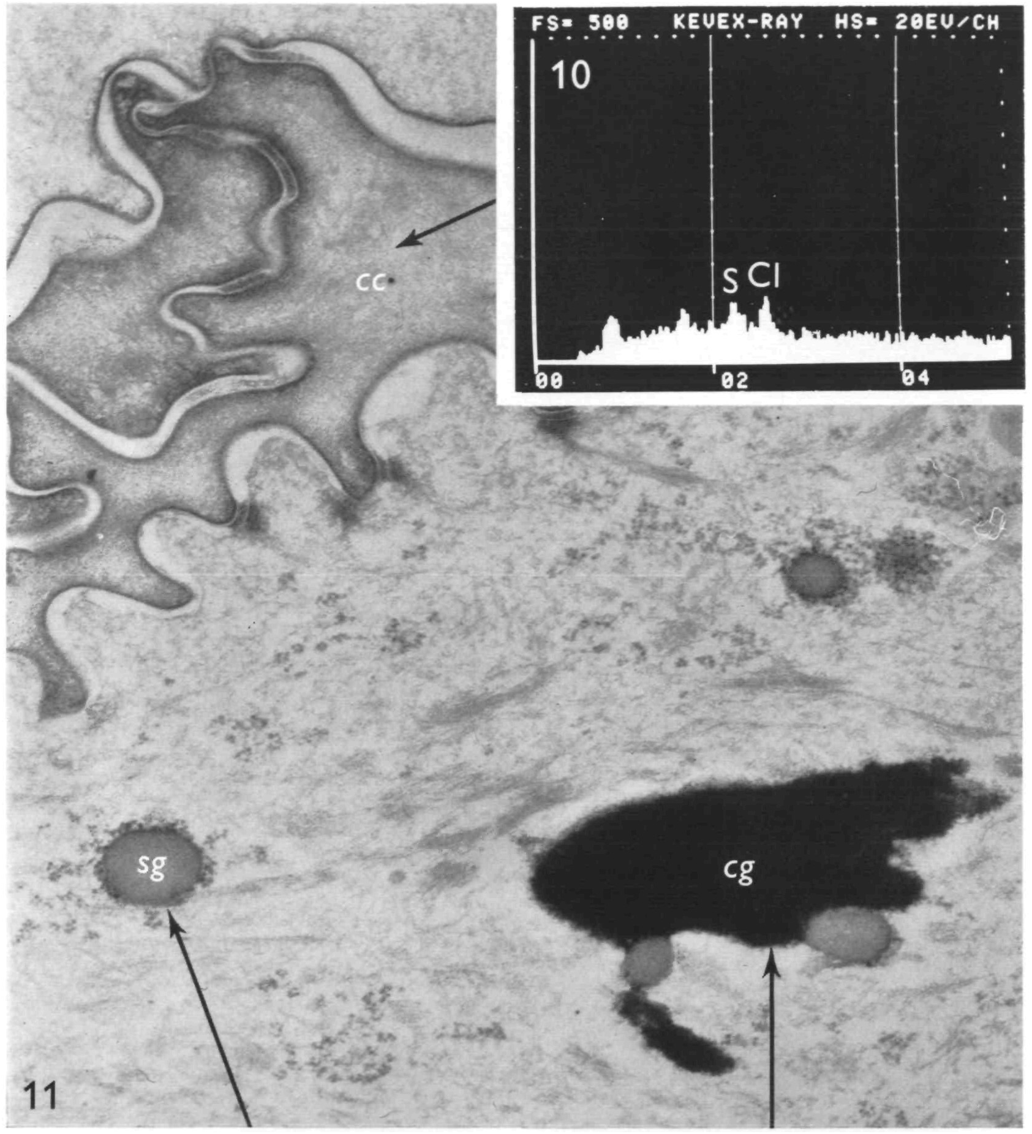
H. Jessen,P. D. Peters,T. A. Hall, Sulphur in different types of keratohyalin granules: a quantitative assay by x-ray microanalysis, J Cell Sci, 1974, Fig. 11.
Fig. 11.
Sulphur in different types of keratohyalin granules: a quantitative assay by x-ray microanalysis
Date downloaded: 4/16/2024
Copyright 2024 The Company of Biologists
Notes:
Figure Caption:
Micrograph showing single granules (sg) and a composite granule (cg) in oesophageal epithelium, cc, cornified cell. Glutaraldehyde-fixed, stained section. × 38000.

Slide 18
H. Jessen,P. D. Peters,T. A. Hall, Sulphur in different types of keratohyalin granules: a quantitative assay by x-ray microanalysis, J Cell Sci, 1974, Fig. 10.
Fig. 10.
Sulphur in different types of keratohyalin granules: a quantitative assay by x-ray microanalysis
Date downloaded: 4/16/2024
Copyright 2024 The Company of Biologists
Notes:
Figure Caption:
Elemental spectrum from analysis of the interior of a cornified cell. Oesophageal epithelium.

Slide 19
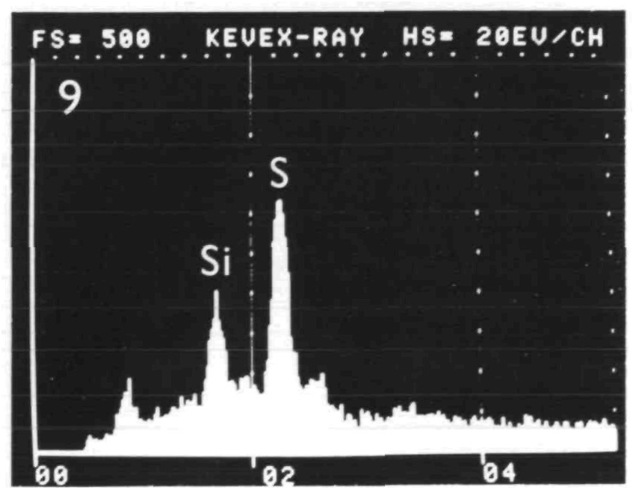
H. Jessen,P. D. Peters,T. A. Hall, Sulphur in different types of keratohyalin granules: a quantitative assay by x-ray microanalysis, J Cell Sci, 1974, Fig. 9.
Fig. 9.
Sulphur in different types of keratohyalin granules: a quantitative assay by x-ray microanalysis
Date downloaded: 4/16/2024
Copyright 2024 The Company of Biologists
Notes:
Figure Caption:
Elemental spectrum from analysis of an intranuclear single granule. Interpapillary tongue epithelium.

Slide 20
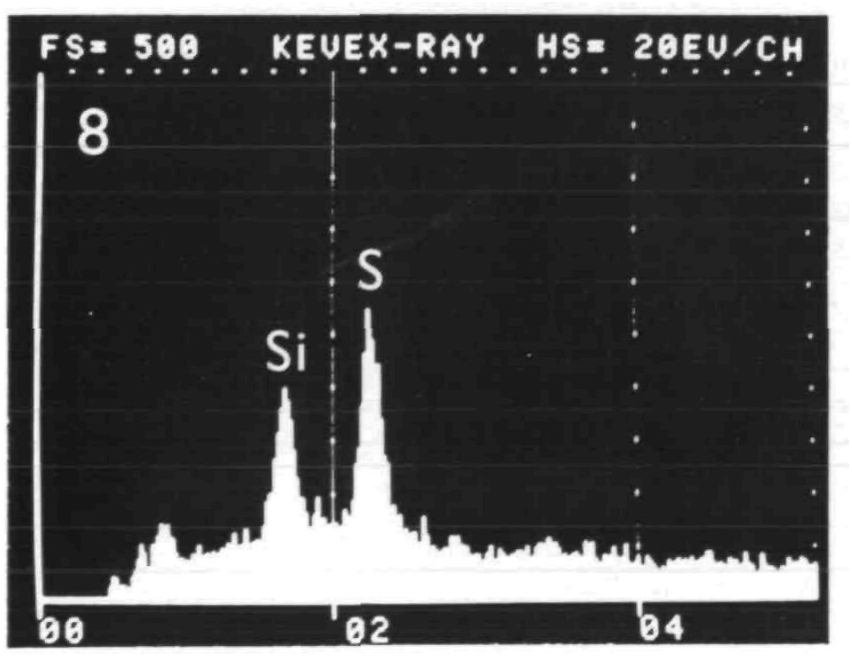
H. Jessen,P. D. Peters,T. A. Hall, Sulphur in different types of keratohyalin granules: a quantitative assay by x-ray microanalysis, J Cell Sci, 1974, Fig. 8.
Fig. 8.
Sulphur in different types of keratohyalin granules: a quantitative assay by x-ray microanalysis
Date downloaded: 4/16/2024
Copyright 2024 The Company of Biologists
Notes:
Figure Caption:
Elemental spectrum from analysis of a cytoplasmic single granule. Interpapillary tongue epithelium.

